Slide 1

PDLC-Design Stage Flowchart

Slide 2

At the end of the lesson students should be able
Define the term flowchart
Describe the purpose of flowchart symbols
Draw simple flowchart to solve problem

Slide 3
What is a Algorithm?
What is an Algorithm It is a step by step process when completed in order will solve a given problem.
Algorithm is represented using
Flowchart
Pseudocode
What is a Flowchart?
A flowchart is a diagrammatic representation of an algorithm.
It shows the steps required to complete a task and the order that they are to be performed.

Slide 4
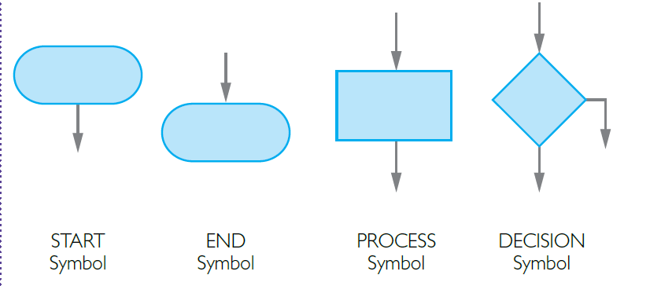
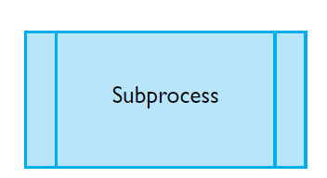
Basic elements of flowcharts
The flowchart symbols denoting the basic building blocks of programming are shown below.
Text inside a symbol is called a label.

Slide 5
Symbols and their meanings
The START symbol represents the start of a process.
The PROCESS symbol is labelled with a brief description of the process carried out by the flowchart.
The END symbol represents the end of a process. It contains either END or RETURN depending on its function in the overall process of the flowchart.

Slide 6
Subprocesses
Subprocesses are useful because:
they help with the modularisation of complex programs;
they provide a way of simplifying programs by making common processes available to a wide number of programs;
they lead to more reliable programs, since once a process is tested and works it can be made into a subprocess and need not be tested again.

Slide 7
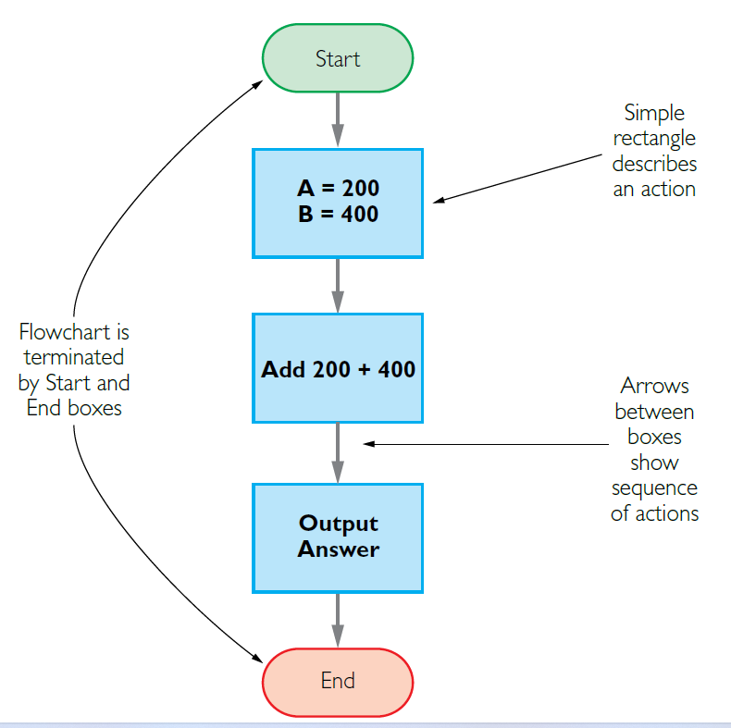
Flowchart Symbols
Flowcharts can be used to plan out programs.
Let’s look at a simple sequence. Say we want to add A to B,
where A = 200 and B = 400.
Start
A = 200 B = 400
Add = 200 + 400
Output = 600
End

Slide 8
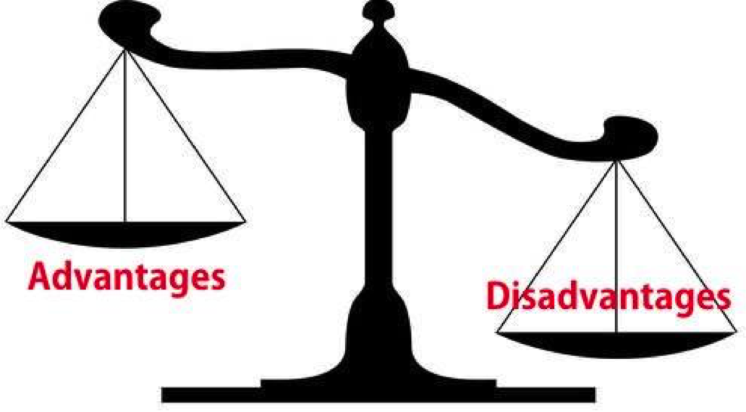
Advantages and disadvantages of using flowcharts
Designing an algorithm using a flowchart has advantages because:
it is easy to see how a program flows
flowcharts follow an international standard - it is easy for any flowchart user to pick up a diagram and understand it
Flowcharts also have their disadvantages:
with a large program, the diagrams can become huge and therefore difficult to follow
any changes to the design may mean a lot of the diagram has to be redrawn

Slide 9
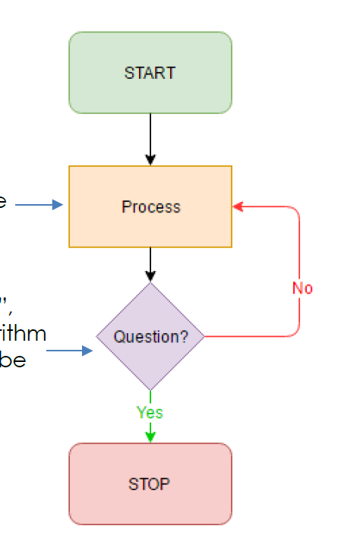
Flowchart decision
Some action has to be repeat a number of times so the flowchart shows this process by using the data flow back to the some process or input that happened before.

Slide 10
Practice
Draw a flow chart to display the larger of 3 numbers
What are the inputs?
What decision is being made?
What will the out be?

Slide 11
Complete the given worksheet

